Slide 1
Survival of the Fittest – a Sophisticated Data Mining Analysis of Shelter Animals
Data Mining Project Presentation
Data and Web Science Group
University of Mannheim
Group 6
15.12.2016

Slide 2
What properties are crucial for animal adoption?

Slide 3

Agenda
Selection
Preprocessing
Transformation
Data Mining
Evaluation & Interpretation
Available data
…….
Target
Data
Preprocessed Data
Transformed Data
Patterns
Adopted from Fayyad et al. (1996)

Slide 4
Selection
Selection
Preprocessing
Transformation
Data Mining
Evaluation & Interpretation
Available data
…….
Target
Data
Preprocessed Data
Transformed Data
Patterns
Adopted from Fayyad et al. (1996)

Slide 5

Selection
Data Sources and Number of Records
Kaggle
Austin Animal Center
Comments
Decided to combine data set from two different sources to achieve improved results
Data records range from October 2013 to February 2016
10 different attributes, represented as polynominals
Dataset lacks completeness and consistency
4,813 have an unknown SexUponOutcome value
76 animals have AgeUponOutcome of ”0 years”
25,159 animals have a combination of at least two colors
AgeUponOutcome uses different time units such as day, month, and year
26,729
25,066
Final dataset for investigation
51,795

Slide 6
Preprocessing
Selection
Preprocessing
Transformation
Data Mining
Evaluation & Interpretation
Available data
…….
Target
Data
Preprocessed Data
Transformed Data
Patterns
Adopted from Fayyad et al. (1996)

Slide 7
Preprocessing
Deriving Attributes
Grouping of Attributes
Normalization
Name
Breed Group
Age Outcome
has Name
Age Normalized
Lucy, Simba, Sparkles, …
+17063 more
Working, Herding, Terrier, Toy, Sporting, Non-Sporting, Hound
5 years, 3 months, 16 days,...+41 more
True, False
1 day – 5600 days
Sex
Size
Color Type
SexUpon Outcome
Breed
Color
Male, Female
Small, Medium, Large
Single-colored, Multi-colored
Fertility
Hair Length
Color Contrast
Intact Male, Intact Female,
Neutered Male, Spayed Female
Chihuahua, German Shepherd, Pointer,...
+1713 more
Black/White, Brown, Torbie, ... +462 more
True, False
Small, Medium, Large
Dark, Light, Mixed

Slide 8
Transformation
Selection
Preprocessing
Transformation
Data Mining
Evaluation & Interpretation
Available data
…….
Target
Data
Preprocessed Data
Transformed Data
Patterns
Adopted from Fayyad et al. (1996)

Slide 9
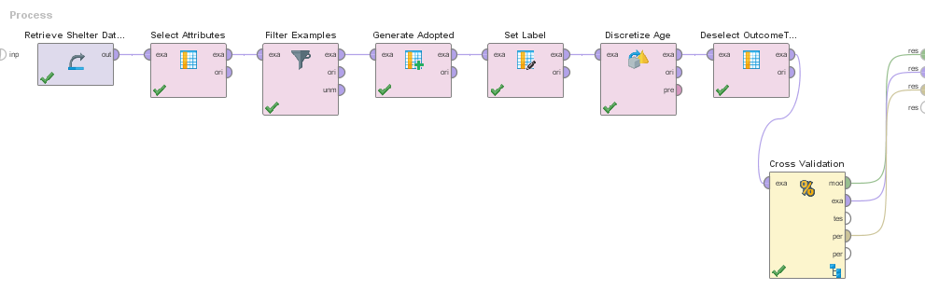
Transformation
Importing preprocessed data set
Filtering records that are incomplete and inconsistent
Discretizing age into three balanced bins
Aggregating outcome types into adopted and not adopted
Creating different attribute subsets

Slide 10
Data Mining
Selection
Preprocessing
Transformation
Data Mining
Evaluation & Interpretation
Available data
…….
Target
Data
Preprocessed Data
Transformed Data
Patterns
Adopted from Fayyad et al. (1996)

Slide 11
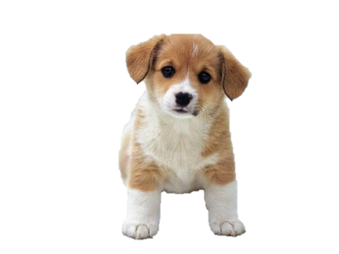
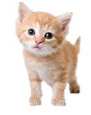
Data Mining
 | Dogs |  | Cats
Classifier | Accuracy (%) | Fmeasure (%) | Accuracy (%) | Fmeasure (%)
k-NN | 71.31 | 66.91 | 80.96 | 78.29
Naïve Bayes | 70.83 | 67.40 | 74.89 | 73.21
Decision Tree | 70.81 | 63.35 | 80.96 | 78.29
Neural Network | 71.15 | 64.94 | 80.31 | 77.97
Rule Induction | 71.20 | 64.65 | 80.96 | 78.29
All of the classifiers perform more or less equally.
Thus, an additional pragmatic and goal-oriented view is required.

Slide 12
Evaluation & Interpretation
Selection
Preprocessing
Transformation
Data Mining
Evaluation & Interpretation
Available data
…….
Target
Data
Preprocessed Data
Transformed Data
Patterns
Adopted from Fayyad et al. (1996)

Slide 13
Evaluation & Interpretation
Final classification model for dogs
Fertility
Comment
Aim was to minimize the classifier’s complexity as well as the occurrence of false positives
The tree structure for cats is essentially the same, but with different age intervals
false
true
Age
Not Adopted
[0;547.5]
[547.5;1,277.5]
[1,277.5; ∞]
Adopted
Not Adopted
Not Adopted
Decision Tree is our chosen adoption prediction model for cats and dogs

Slide 14
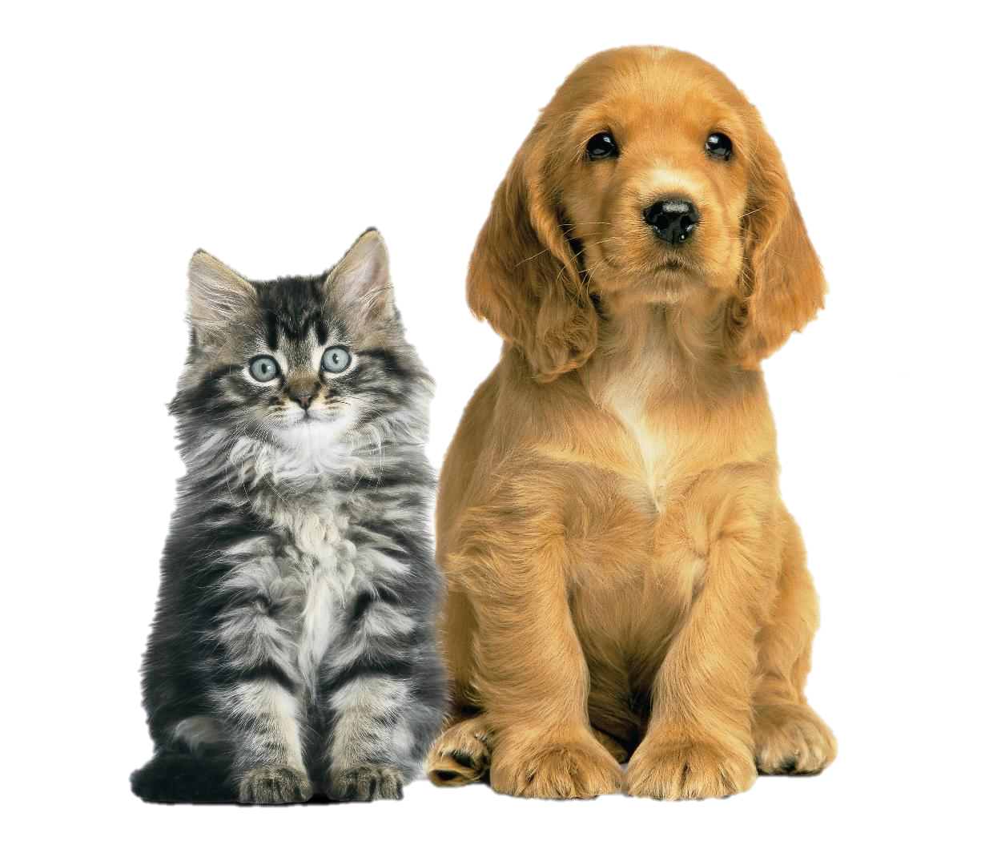
What properties are crucial for animal adoption?
Breed Group
Color Contrast
Size
Color Type
Sex
Age
Fertility
Hair Length
Our classifier yields that only age and fertility are important properties for animal adoption

Slide 15





Questions & Answers
Daniel Helfer
Timo Sturm
Christoph Wagner
Benjamin Socher

Slide 16
Sources
Pictures (Retrieved on 11.12.2016):
http://3.bp.blogspot.com/-PbkFNzdNMwc/U2wQhbWQ8gI/AAAAAAAAAUk/ih65CmBwAz0/s1600/fakta+anjing+dan+kucing.jpg
http://doxenkennelclub.wikia.com/wiki/File:So-cute-puppies-14749028-1600-1200.png
http://bilderfordeutch.blogspot.de/2016/02/katze.html

Slide 17
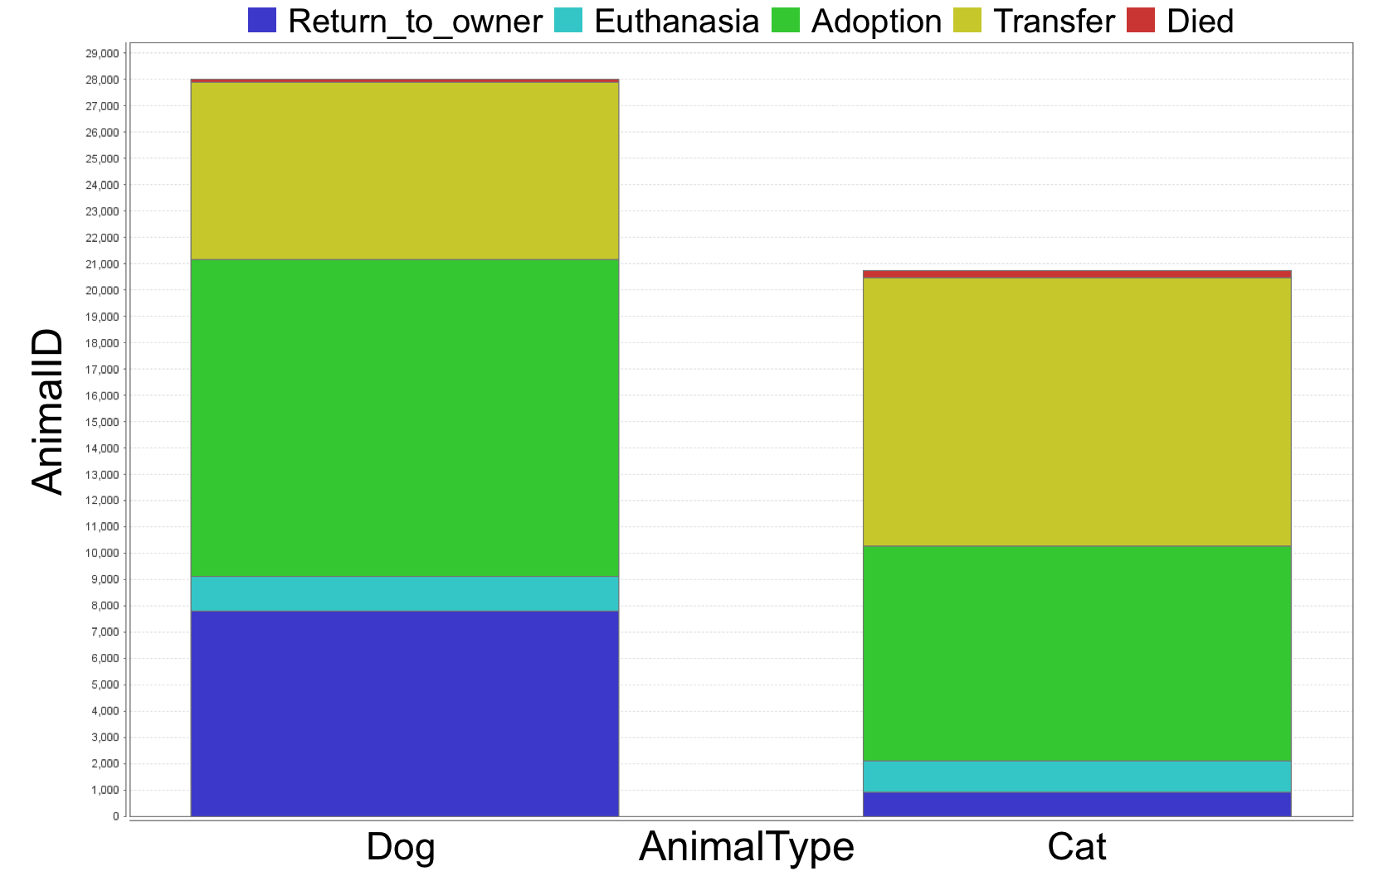
Backup

Slide 18
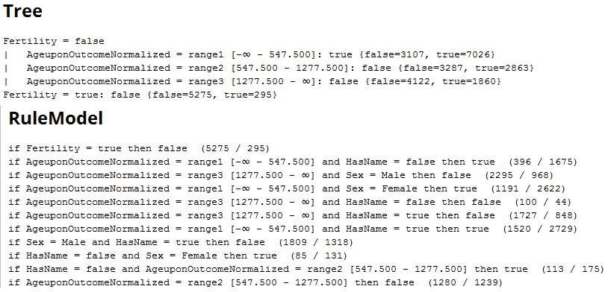
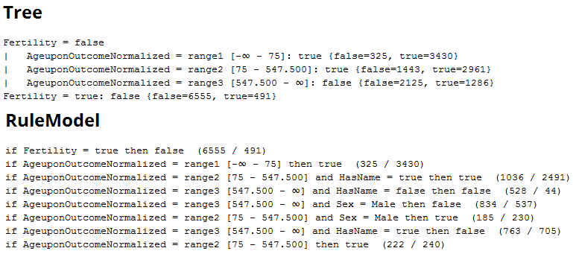
Backup
Dogs
Cats

Slide 19
Backup
Final classification model for cats
Fertility
false
true
Age
Not Adopted
[0;75]
[75;547.5]
[547.5; ∞]
Adopted
Adopted
Not Adopted
Decision Tree is our chosen adoption prediction model for cats and dogs

